Slide 1
XAI for Cash Flow
CWB

Slide 2
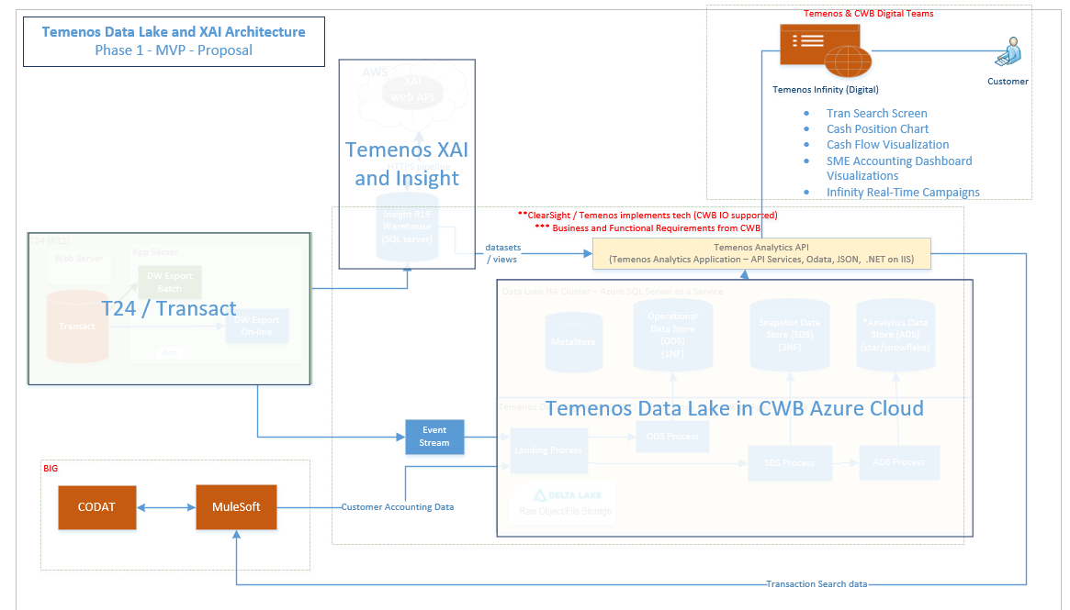
High Level Scope

Slide 3
Scope Breakdown
Past
Past cash flows – P1
Past payments and receipts summary – P1
Past payments per suppliers and receipts per customers – P3
…
Present
Payables and receivables summary – P3
Payables and receivables overdue – P3
Future
Cash flow predictions with XAI – P2
Payables and receivables prediction – P4
Payments per suppliers and Receipts per customer predictions – P4

Slide 4
Scope Breakdown
Visualizations
Past
Past cash flows
Past payments and receipts summary
Past payments per suppliers and receipts per customers
Present
Payables and receivables summary
Payables and receivables overdue
Future
Cash flow predictions with XAI
Payables and receivables prediction
Payments per suppliers and Receipts per customer predictions
Data Sources
Temenos data warehouse and analytics (OOTB)
Moody’s data (for company/directors’ Credit scores, age etc.)
CODAT (accounting data)
Channels
Infinity for small businesses (OOTB)
Mobile for small businesses
Small businesses platform (TBD)

Slide 5
Scope with Priority and Dependency
Past
Past cash flows – P1
Past payments and receipts summary – P1
Past payments per suppliers and receipts per customers – P3
Present
Payables and receivables summary – P3
Payables and receivables overdue – P3
Future
Cash flow predictions with XAI – P2
Payables and receivables prediction – P4
Payments per suppliers and Receipts per customer predictions – P4
P1 and P2 (Infinity launch together or fast follow)
With available data sources and Integrations
P3 (fast follow P1 & P2)
Past and present with CODAT integration
P4 (fast follow P3)
Future with CODAT integration and training
P5 (TBD)
Moody’s and other data sources

Slide 6
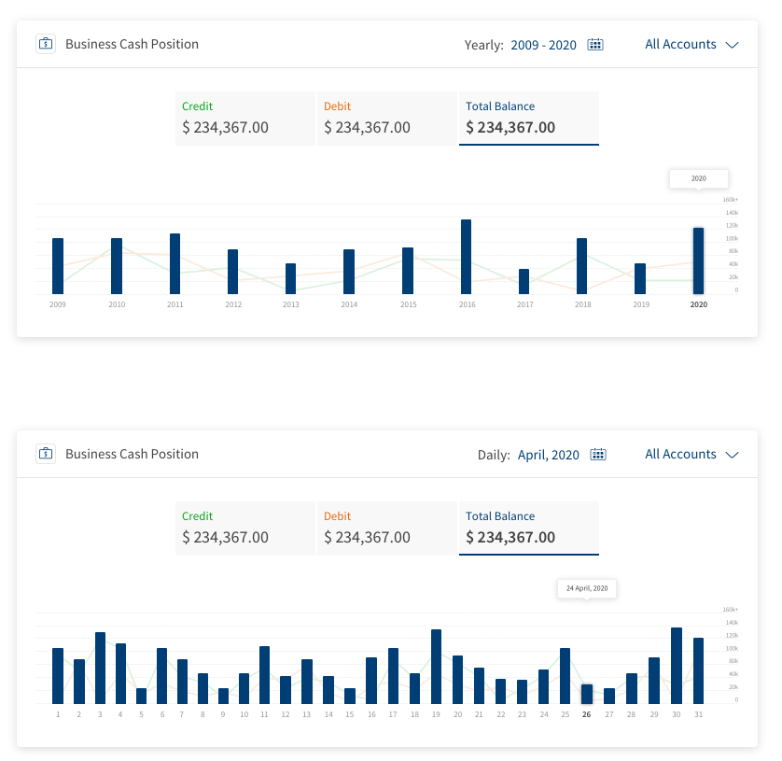
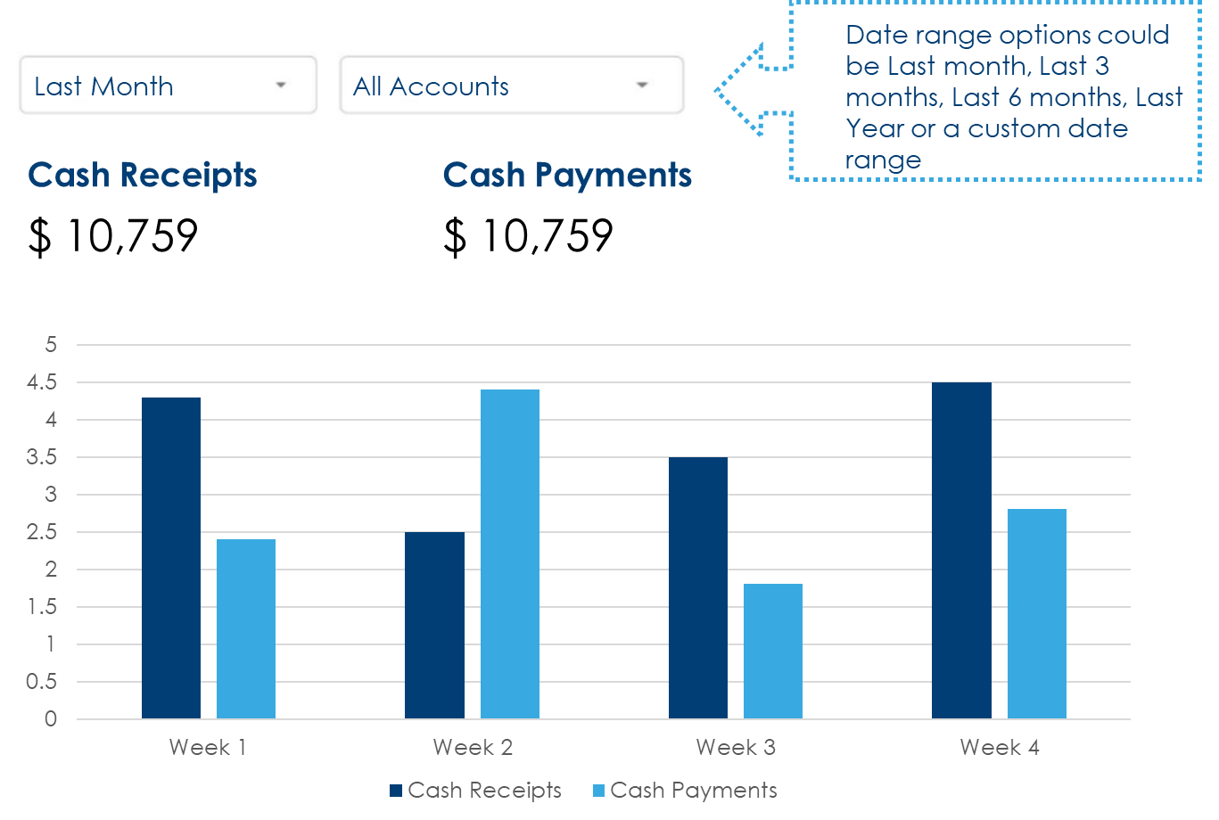
P1 – Views with available data sources
Past payments and receipts summary – P1
OR
Notes:
Temenos shared the first picture with CODAT data, but can we have it without CODAT?
Filters:
Last 1, 3, 6 months (or more?)
Accounts (all or selection)

Slide 7
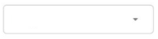
P1 – Views with available data sources
Past cash flows
3 months
Notes:
Temenos did not share this visualization for past data – this is our own request
Filters:
Last 1, 3, 6 months (or more?)
Accounts (all or selection)

Slide 8
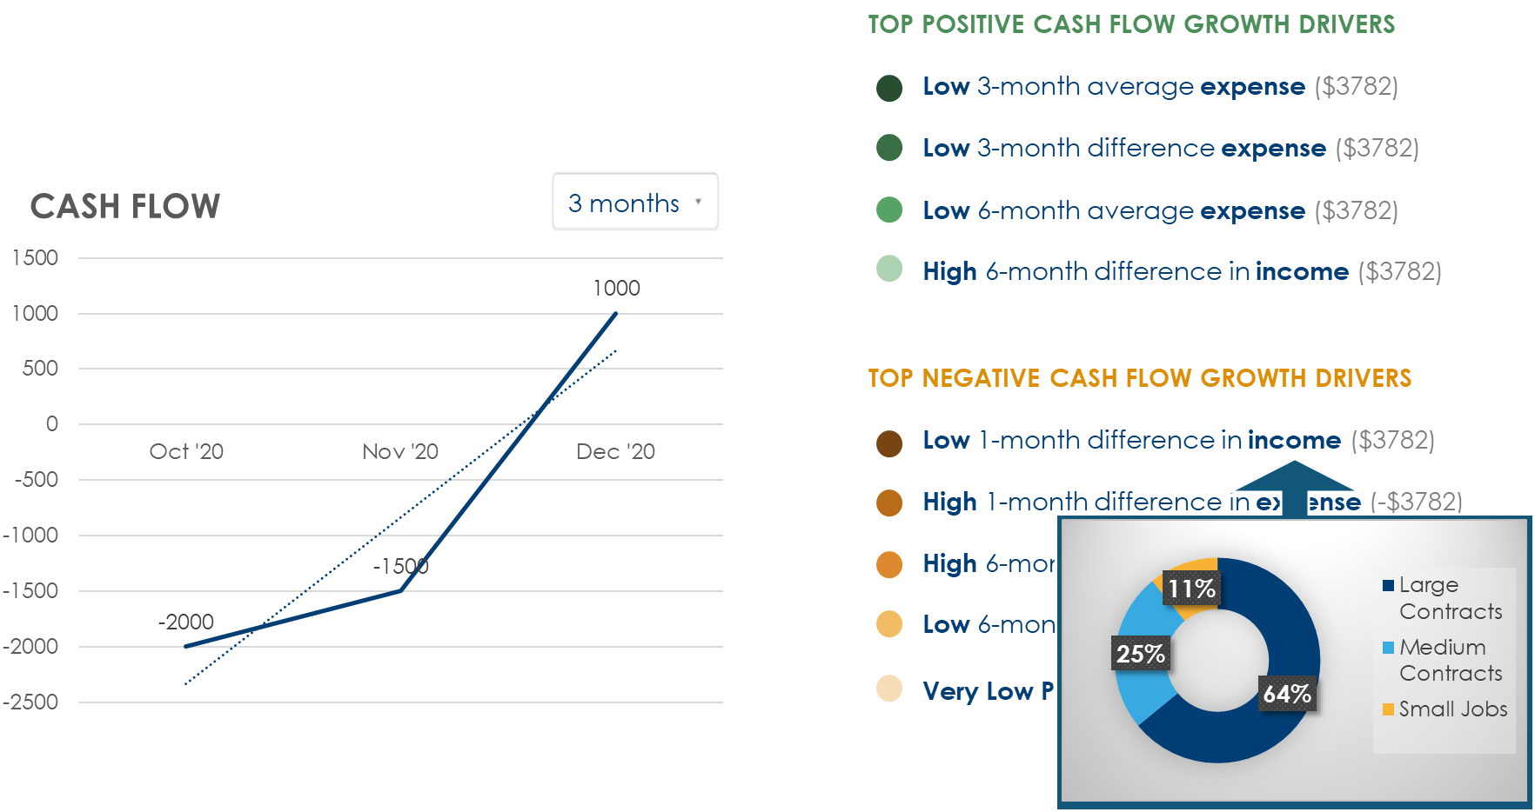
P2 – Views with available data sources
Future cash flow predictions
Notes:
Filters:
Future 1, 3, 6 months (or more?)
No account selection
Top drivers (+ves and –ves)
Option to drill down – explain the prediction
What-if analysis?

Slide 9
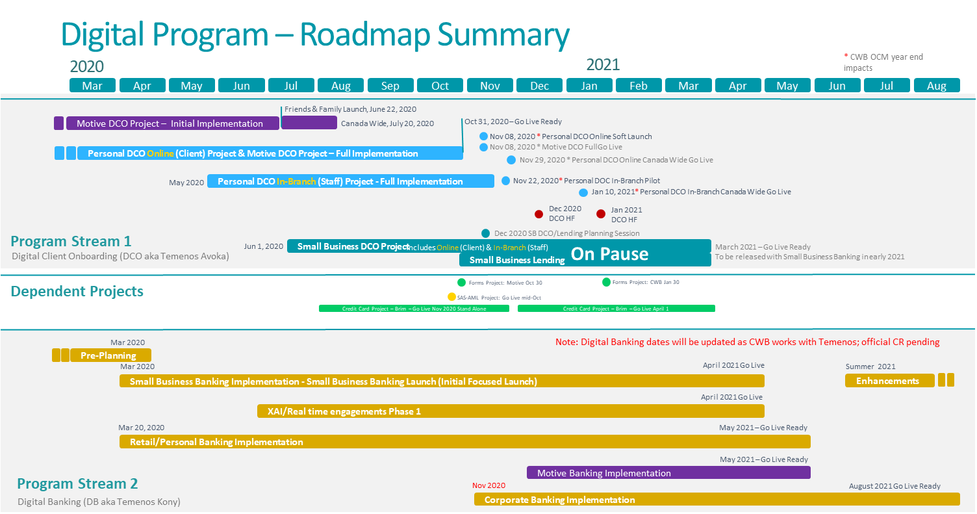
Taken from Digital Program overview

Slide 10
Estimation
Plan shared by Temenos in Sep
Not required for P1/P2
Use Case | Effort (Man Days) | Activities & Assumptions
Display Cash Flow prediction (XAI) | 15 | Integrate with XAI API to fetch Cash flow prediction and factors contributing to the prediction Create UI Visualization to represent the data graphically in MB & OLB
Display Cash Position chart | 5 | Integrate with TDL API to fetch money-in, money-out and available balance information by duration and account types Display information in Cash Position tile available in Base Infinity product
Accounting Dashboard – Visualizations | 95 | Integrate with CODAT & TDL APIs to fetch data for different Visualizations Create UI Visualization to represent the data graphically in MB & OLB
Entitlement changes | 12 | Extend the Entitlement framework to support new features by Business Customer roles defined in Spotlight
Consent Management | 35 | Integrate with CODAT APIs for Authorization and consent management Create 5-6 UI Screens on Mobile Banking (MB) & Online Banking (OLB) Assuming Mule soft layer will store User consent data and use for pulling & pushing the data between CODAT & TDL
QA Effort | 90
Total | 252
Notes:
Cash flow prediction is required
Cash position is one dashboard view in Temenos presentation

Slide 11
CWB Support Requirements
Shared by Temenos in Sep
To deliver the architecture and functionality as described we will need support from CWB to provide:
Infrastructure as specified by Mark Terry in his stream
Bank SME expertise in support of dashboard design and insights/APIs required
Bank SME expertise in validating the cash flow model
Hoa and team
We are doing this
Edmund working on this
Notes:
This is what Temenos team wanted us to do.
I understand Hoa and IM team will work on the infra piece while we here can start working on the dashboard design for P1 and P2 items for now.
Not sure about how we will validate the cash flow model though.

Slide 12
Next Steps
Develop agreement on the process to follow for this project and create a plan for launch – Dino,Faizan
Identification of the project team members at CWB - Dino
Hoa/Mark Terry and team to engage with Temenos for the infra – Mark, Hoa
We will start working on the required visualizations with PO and UX – Sandra, Faizan, Edmund
Parallel efforts for CODAT integration – Dino, Faizan
Notes:
Can we have people take responsibility of these tasks?

Slide 13
Next Phases

Slide 14
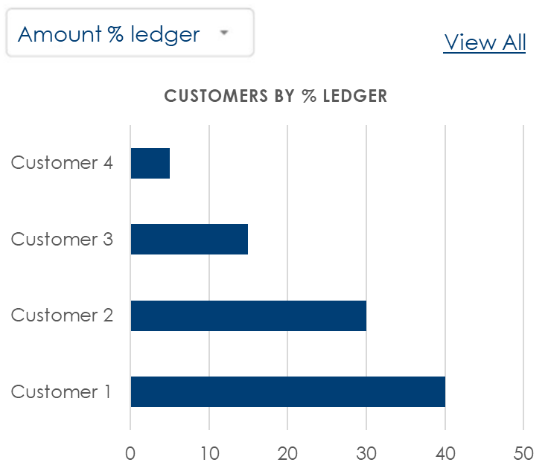
P3 – Past and present with CODAT
Past payments per suppliers and receipts per customers

Slide 15
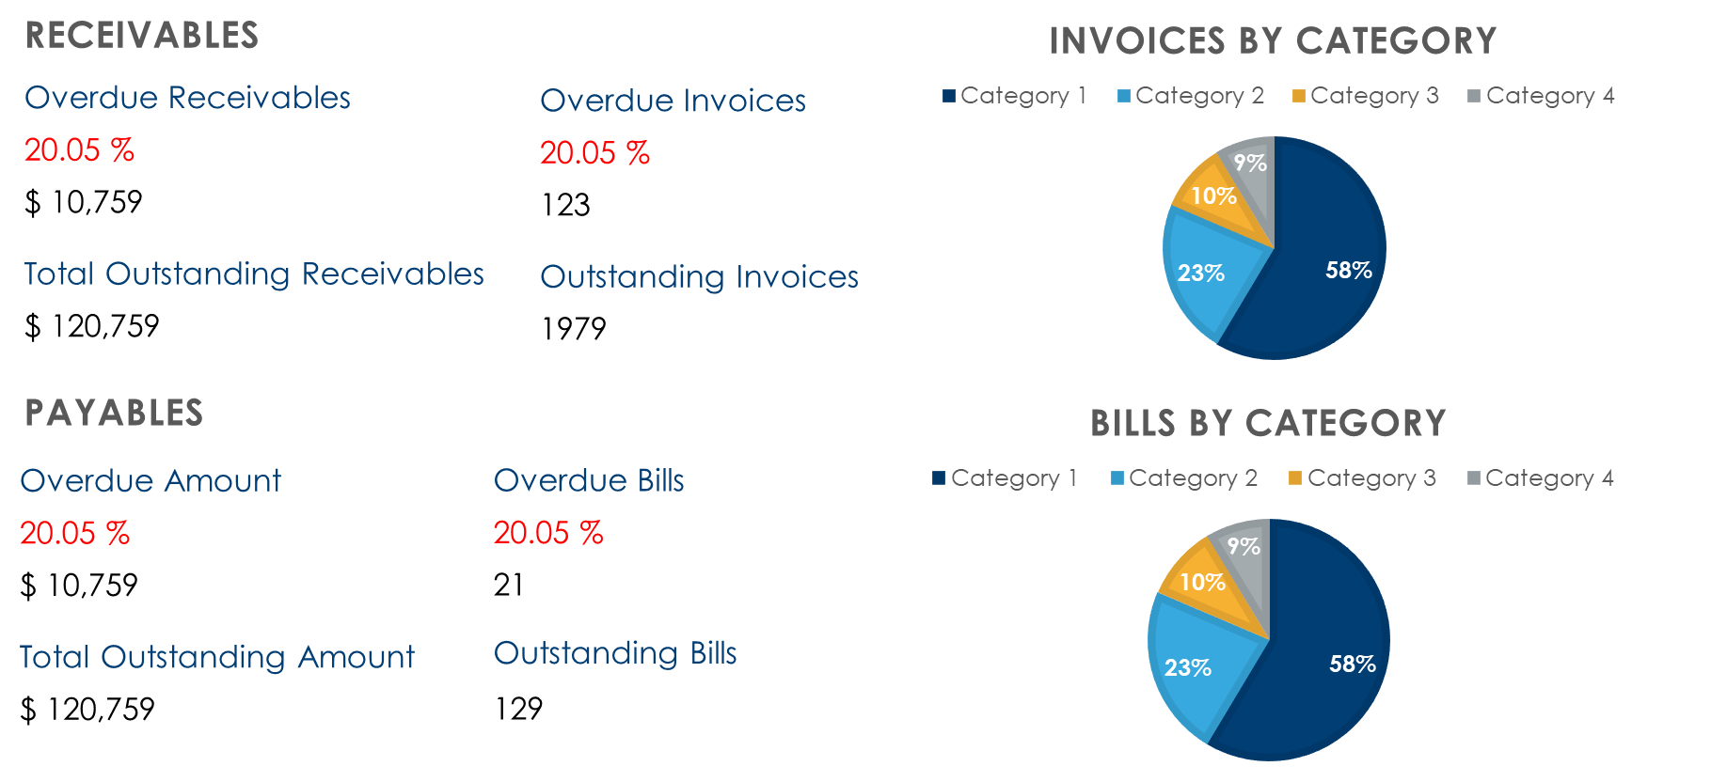
P3 – Past and present with CODAT
Payables and receivables summary

Slide 16
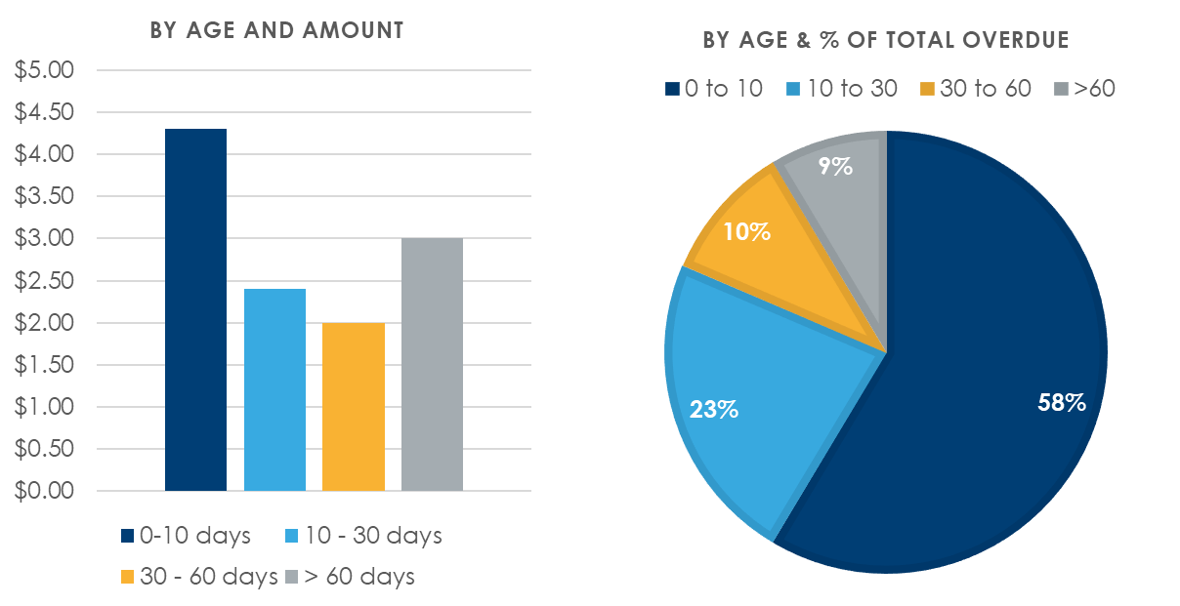
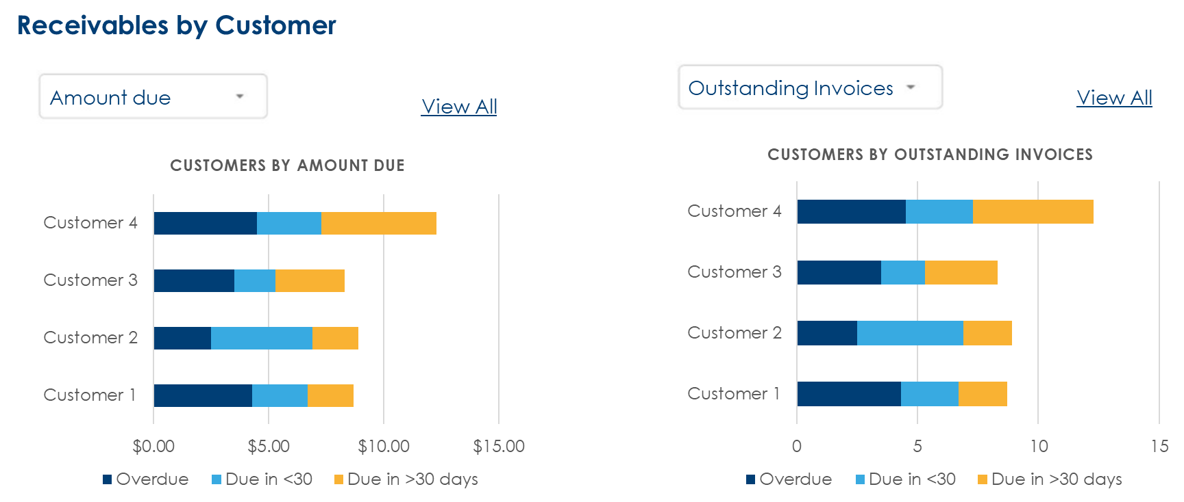
P3 – Past and present with CODAT
Payables and receivables overdue

Slide 17
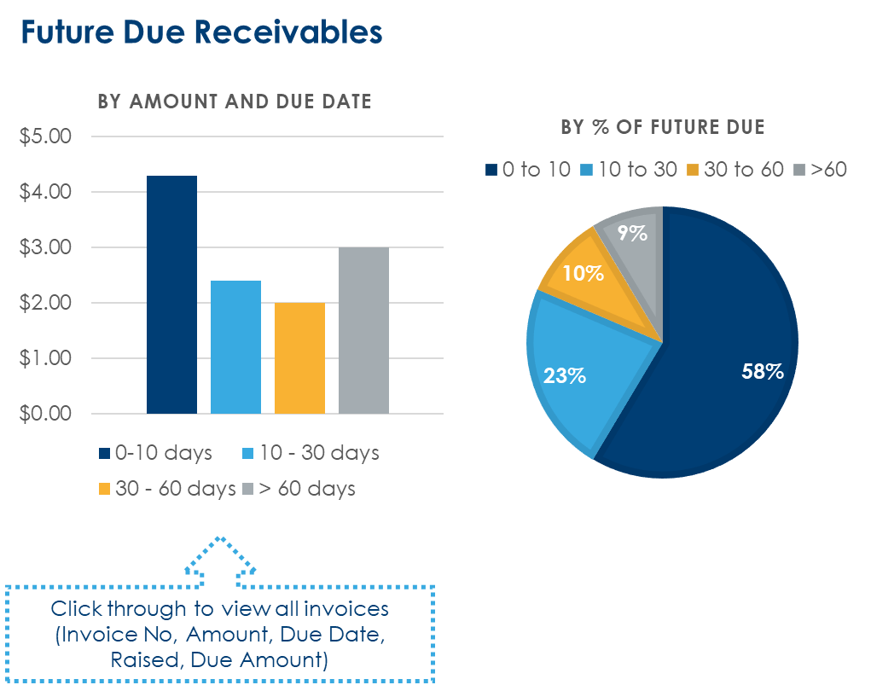
P4 – Future with CODAT
Payables and receivables predictions

Slide 18
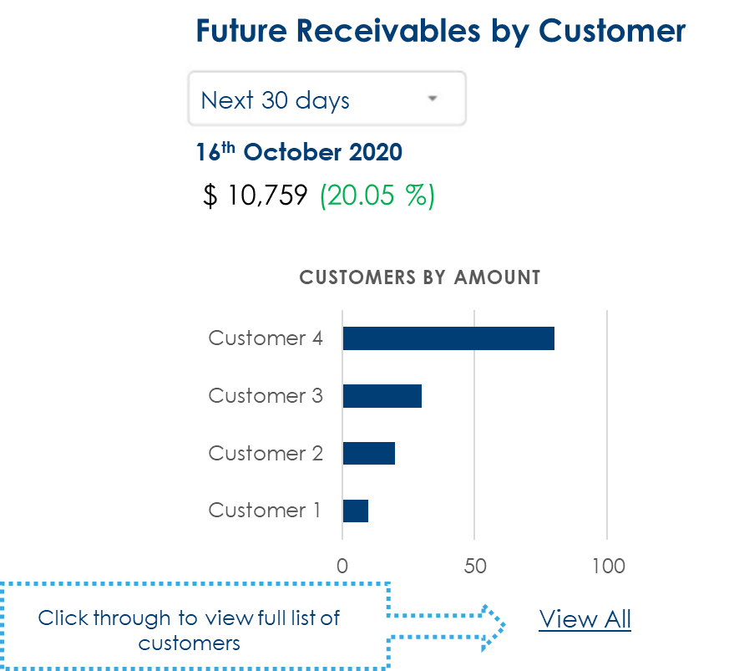
P4 – Future with CODAT
Payments per suppliers and Receipts per customer predictions

Slide 19
P5 – Newer data sources/Other models

